Slide 1
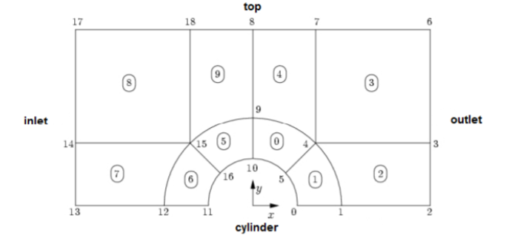
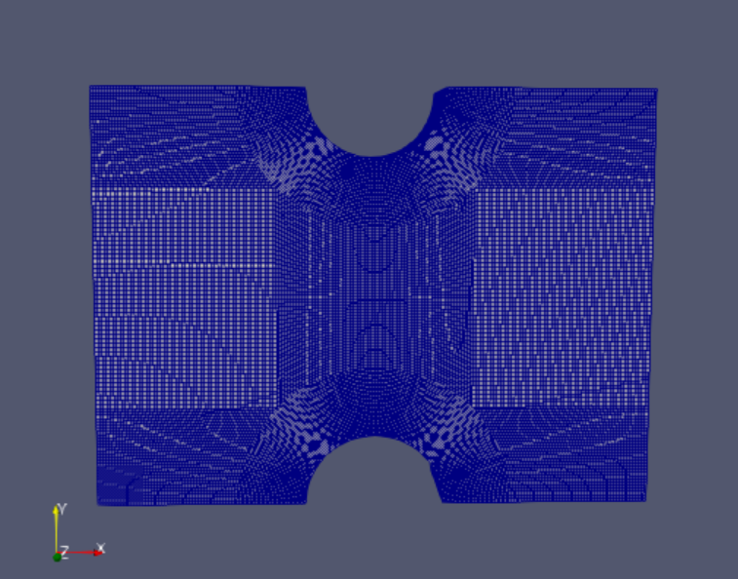
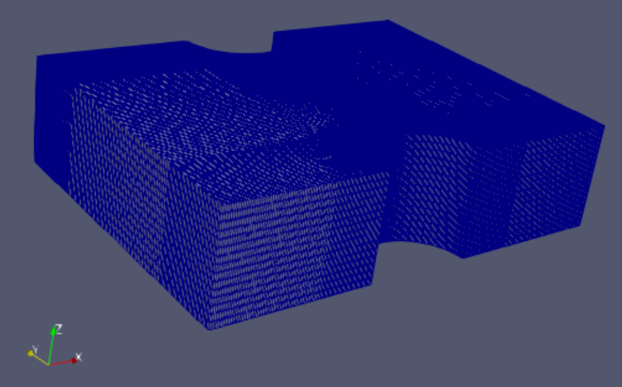
Physical Domain with Cyclic Boundary in inlet and outlet
Two semi cylinderds ,16 blockes
BlockMesh

Slide 2
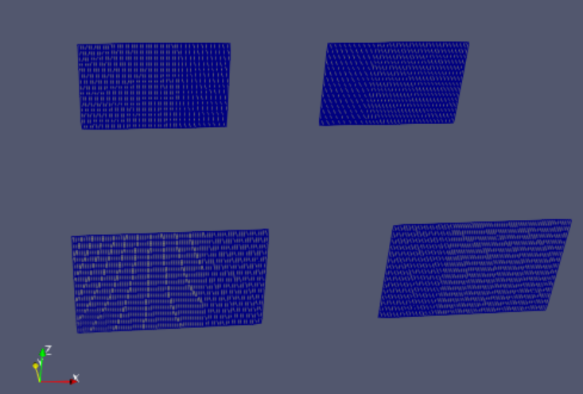
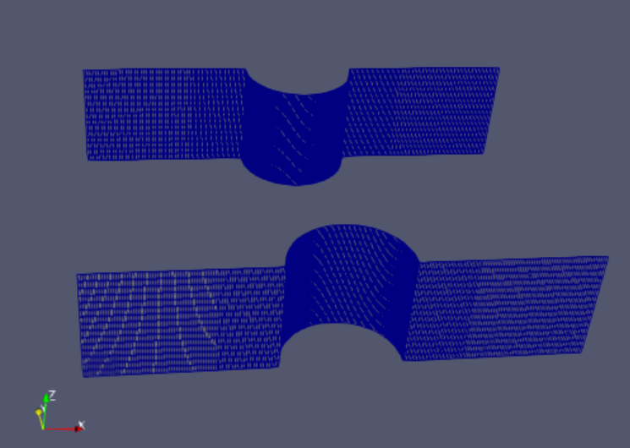
Cyclic B.C
Cylinder patches are wall

Slide 3
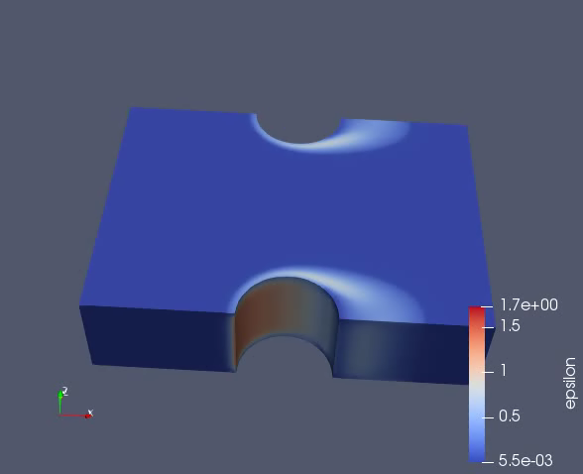
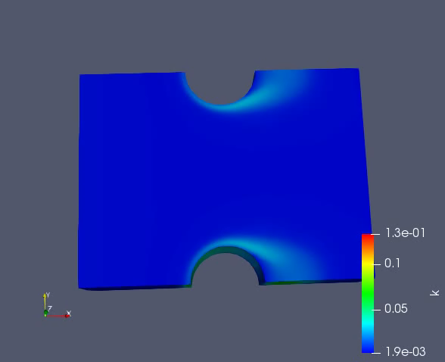
CFD: k-ε model, Solver PISO
ε profile(kinetic energy dissipation rate )
K profile( turbulence kinetic energy )

Slide 4
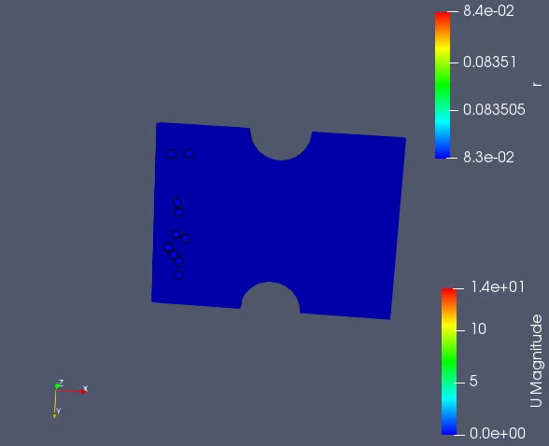
CFD-DEM
Laminar

